Slide 1








Flora
Training company Flora d.o.o.
Class 4.b/2025.
School of Economics and Administration Bjelovar
Croatia

Slide 2

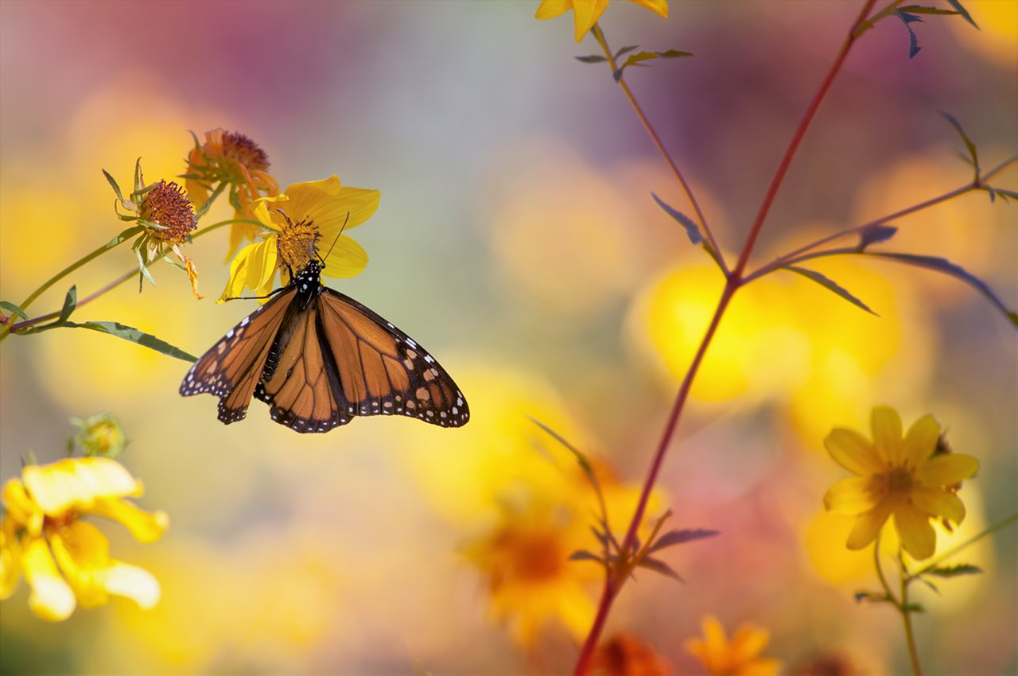





Activity
Flora Ltd. is engaged in the sale of medicinal, aromatic, and honey-bearing herbs.
Our mission is to meet customer needs by offering natural, high-quality, and eco-friendly products.
We participate in fairs and events both in Croatia and abroad, promoting the importance of herbal production and sustainable living.
🌿 A blend of tradition, nature, and modern design!

Slide 3




About us
Flora Ltd.
Poljana dr. Franje Tuđmana 9
43000 Bjelovar, Croatia
Teacher mentor: Marija Dušek
Organizational Structure of the Company
Accounting
Head: Lorena Koruga
Officer: Lovro Šostaric
Marketing
Head: Zvončica Šimunić
Officer: Melani Lazić
Flora
Administration
Head: Nina Vujčić
Officer: Lena Silva
Sales
Head: Ema Križan
Procurement
Head: Iva Kenđelić
Officer: Jan Pelin
💡 Young entrepreneurs building a sustainable future with enthusiasm!

Slide 4

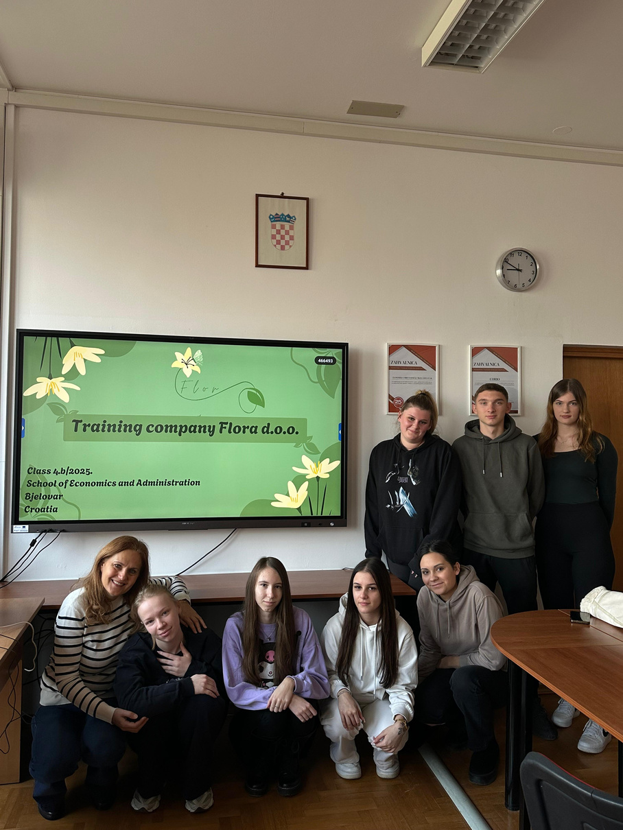


Our Team – The Power of Ideas and Unity 🌟
Meet the creative Flora team – young entrepreneurs connecting knowledge,
nature, and innovation.
👉 See you soon! 💚

